Slide 1
The Dark Side of the
Roaring Twenties

Slide 2
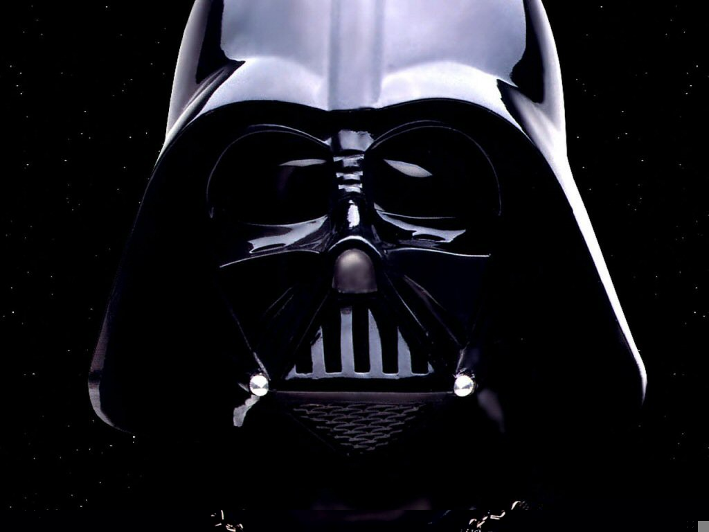
The Roaring Twenties
A Time of economic growth, more leisure time, fun, and freedom!
But there was a “Dark Side” to the Twenties

Slide 3
The “Dark Side” of the Twenties
Intolerance – Refusal to accept people who are different because of:
Race
Background
Opinions
Beliefs

Slide 4
The “Dark Side” of the Twenties
People who were left out included:
Farmers
Immigrants
African Americans

Slide 5
The “Dark Side” of the Twenties
The “Red Scare” – The Federal Government arrested communists and other radicals who wanted to overthrow the government.
Often without any evidence
Trampled Civil Liberties (guaranteed freedoms)
Fear of Radicalism outweighed civil rights.

Slide 6
The “Dark Side” of the Twenties
Revival of the Ku Klux Klan (KKK):
Mob violence against:
African Americans
Immigrants
Catholics
Jews
All seen as “Un-American”

Slide 7
The “Dark Side” of the Twenties
Discrimination &Limits on Immigration:
The numbers of people who could come to America was reduce to 97,000 in 1929.
None from Asia
Couldn’t marry white people, or own land.

Slide 8
The “Dark Side” of the Twenties
The Scopes Trial:
Tennessee – A teacher taught the theory of evolution violating state law.
A trial was held. Great lawyers battled.
Traditionalists wanted the “story of Devine Creation of man” as taught in the Bible
Scopes was found guilty. (Fined $100.00)
The debate still goes on today.

